Slide 1
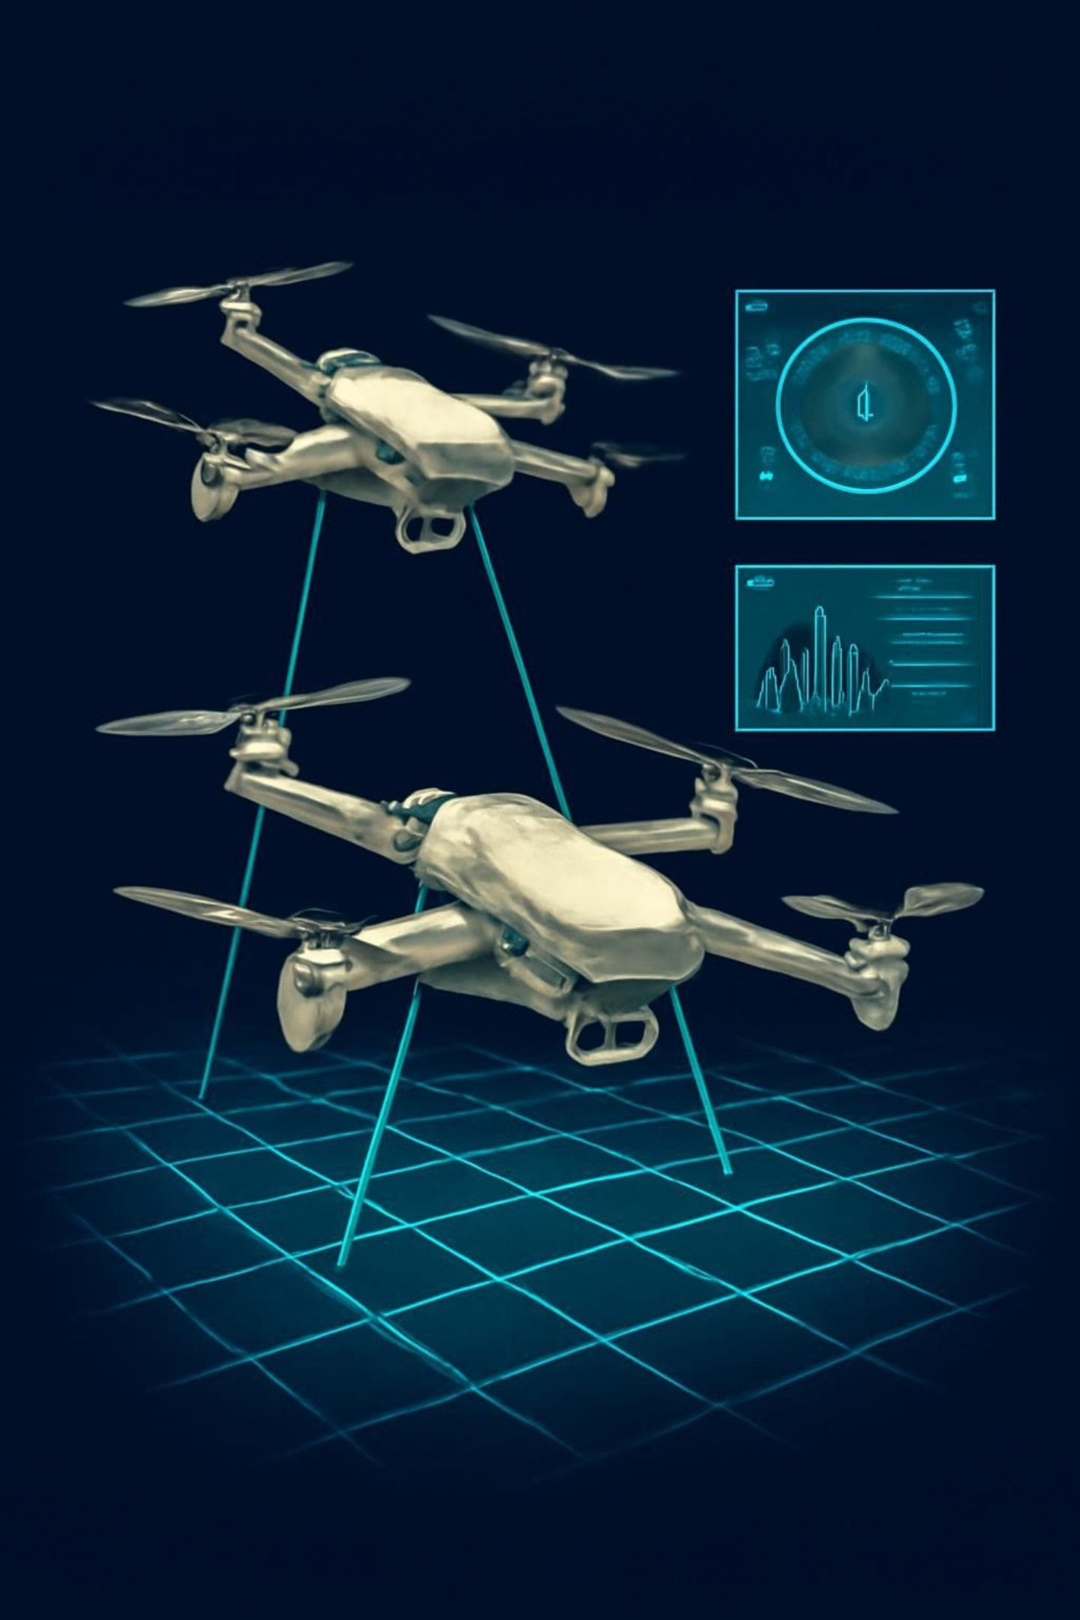
CONTEXTUAL BANDIT-BASED ADAPTIVE SYNCHRONIZATION AND RETRAINING OF UAV NETWORK DIGITAL TWINS
Machine Learning-Based Adaptive Multi-UAV Coordination
Machine Learning (25SC2107E) — Project Review 2
Team Members:
N. Hasini - 2520040039
Sai Lahari - 2520040023

Slide 2
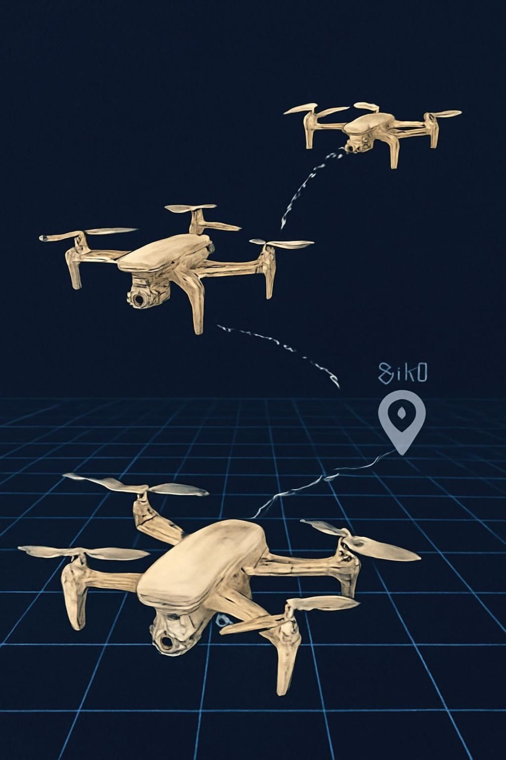
PROBLEM STATEMENT — UAVs Do Not Always Arrive Together
Different distances and speeds create arrival-time mismatch under varying operational conditions. Environmental context (TRAFFIC, LOAD, COST) changes dynamically, so fixed control policies produce poor temporal alignment.
Prototype arrival times
Initial synchronization error
UAV 1 → 35.36 s · UAV 2 → 44.72 s · UAV 3 → 22.36 s
7.8567 (time spread metric)
Decision question
WHAT SHOULD THE UAV DO NOW? → MOVE | WAIT / RETAIN | RETRAIN

Slide 3






PROPOSED METHOD — FROM PREDICTION TO ADAPTIVE DECISION
STEP 1 — UAV STATE
Distance · Current speed · Arrival time · Synchronization error
STEP 2 — ML SPEED PREDICTION
Model predicts required speed to minimize arrival-time spread
STEP 3 — SYNCHRONIZATION
Compare predicted arrival times and compute sync error
STEP 4 — CONTEXT
Traffic · Load · Cost · Synchronization error
STEP 5 — CONTEXTUAL BANDIT
Select: MOVE · WAIT/RETAIN · RETRAIN
STEP 6 — RE-EVALUATE
Observe environment changes → feedback to CONTEXT (loop)

Slide 4
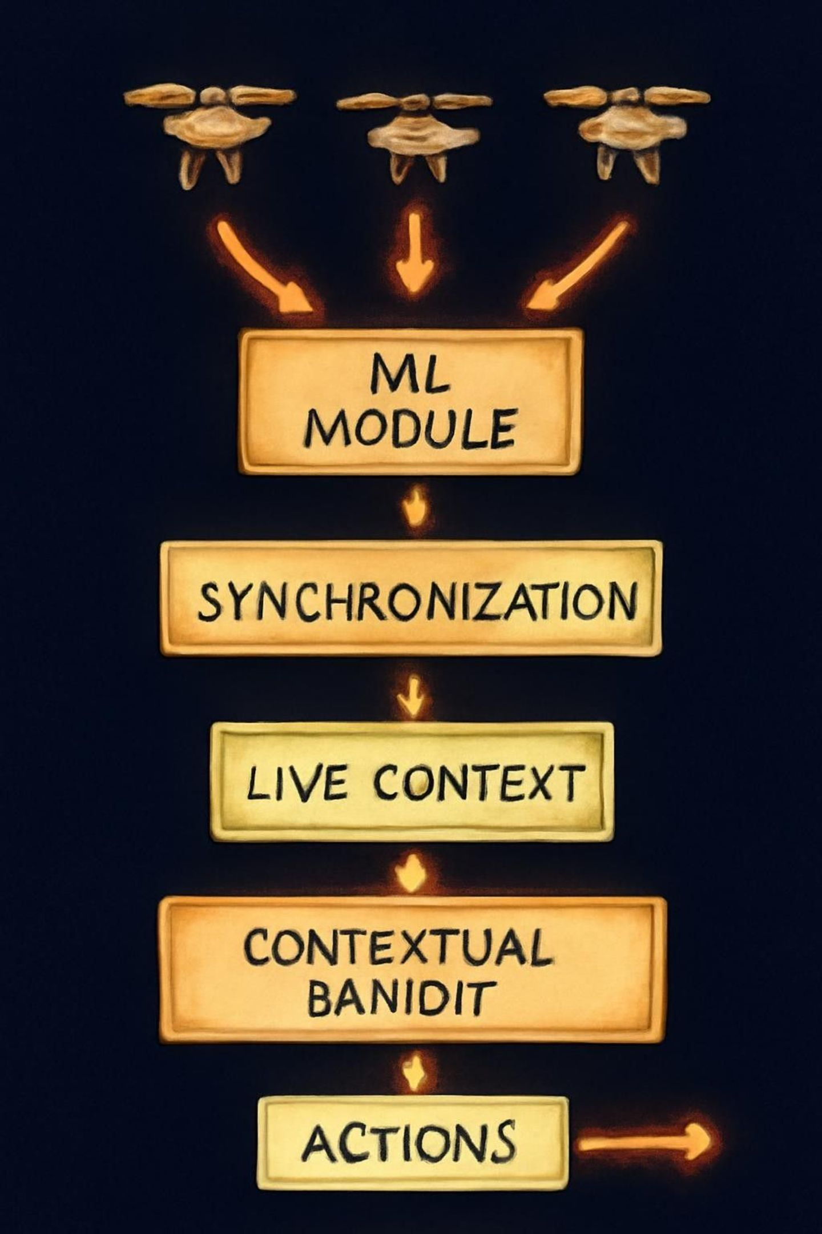
PROJECT WORKFLOW/IMPLEMENTATION
The control flow: UAV telemetry → ML speed prediction → synchronization check → live context aggregation → contextual bandit decision (MOVE / WAIT / RETRAIN) → action execution → environment changes → re-evaluation. RETRAIN routes back to ML SPEED PREDICTION to update the model when accuracy degrades.
Visualization includes one UAV holding position to illustrate WAIT/RETAIN and glowing arrows showing continuous feedback.

Slide 5
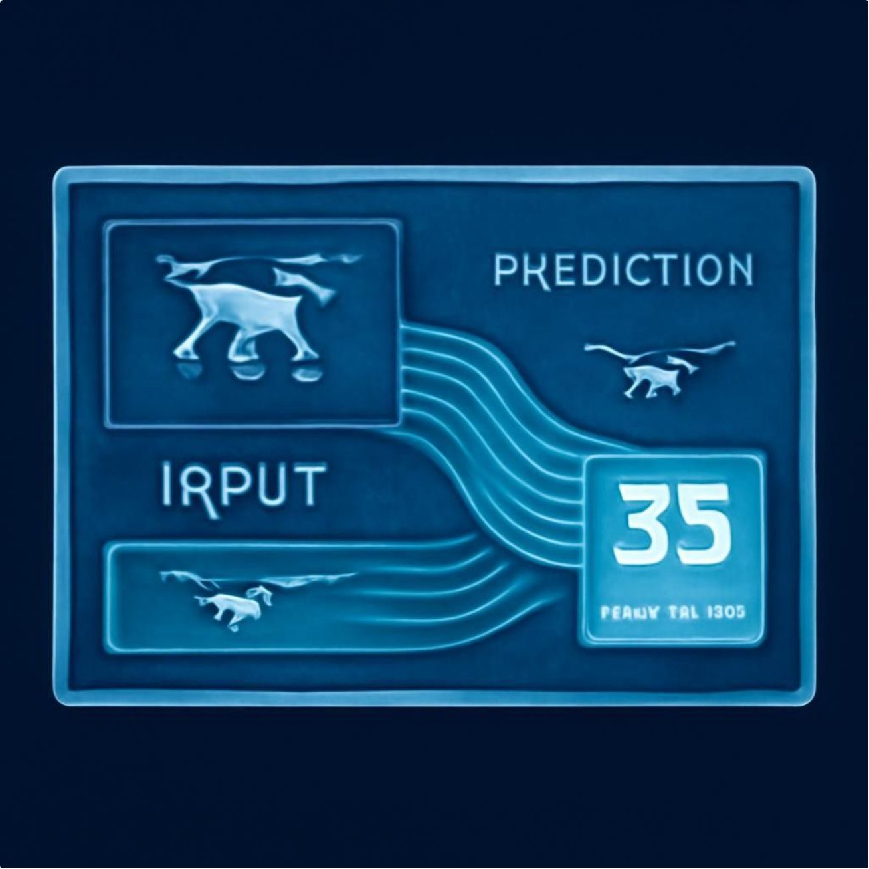
LAYER 1 — ML-BASED SPEED SYNCHRONIZATION
Prototype implementation — prediction examples
UAV 1 — Distance: 28.28 m · Original speed: 0.8 m/s · ML predicted speed: 0.629 m/s
UAV 2 — Distance: 22.36 m · Original speed: 0.5 m/s · ML predicted speed: 0.498 m/s
UAV 3 — Distance: 22.36 m · Original speed: 1.0 m/s · ML predicted speed: 0.496 m/s
Data
Evaluation
Training samples: 800 · Testing samples: 200
MAE: 0.0294 · R²: 0.9891

Slide 6
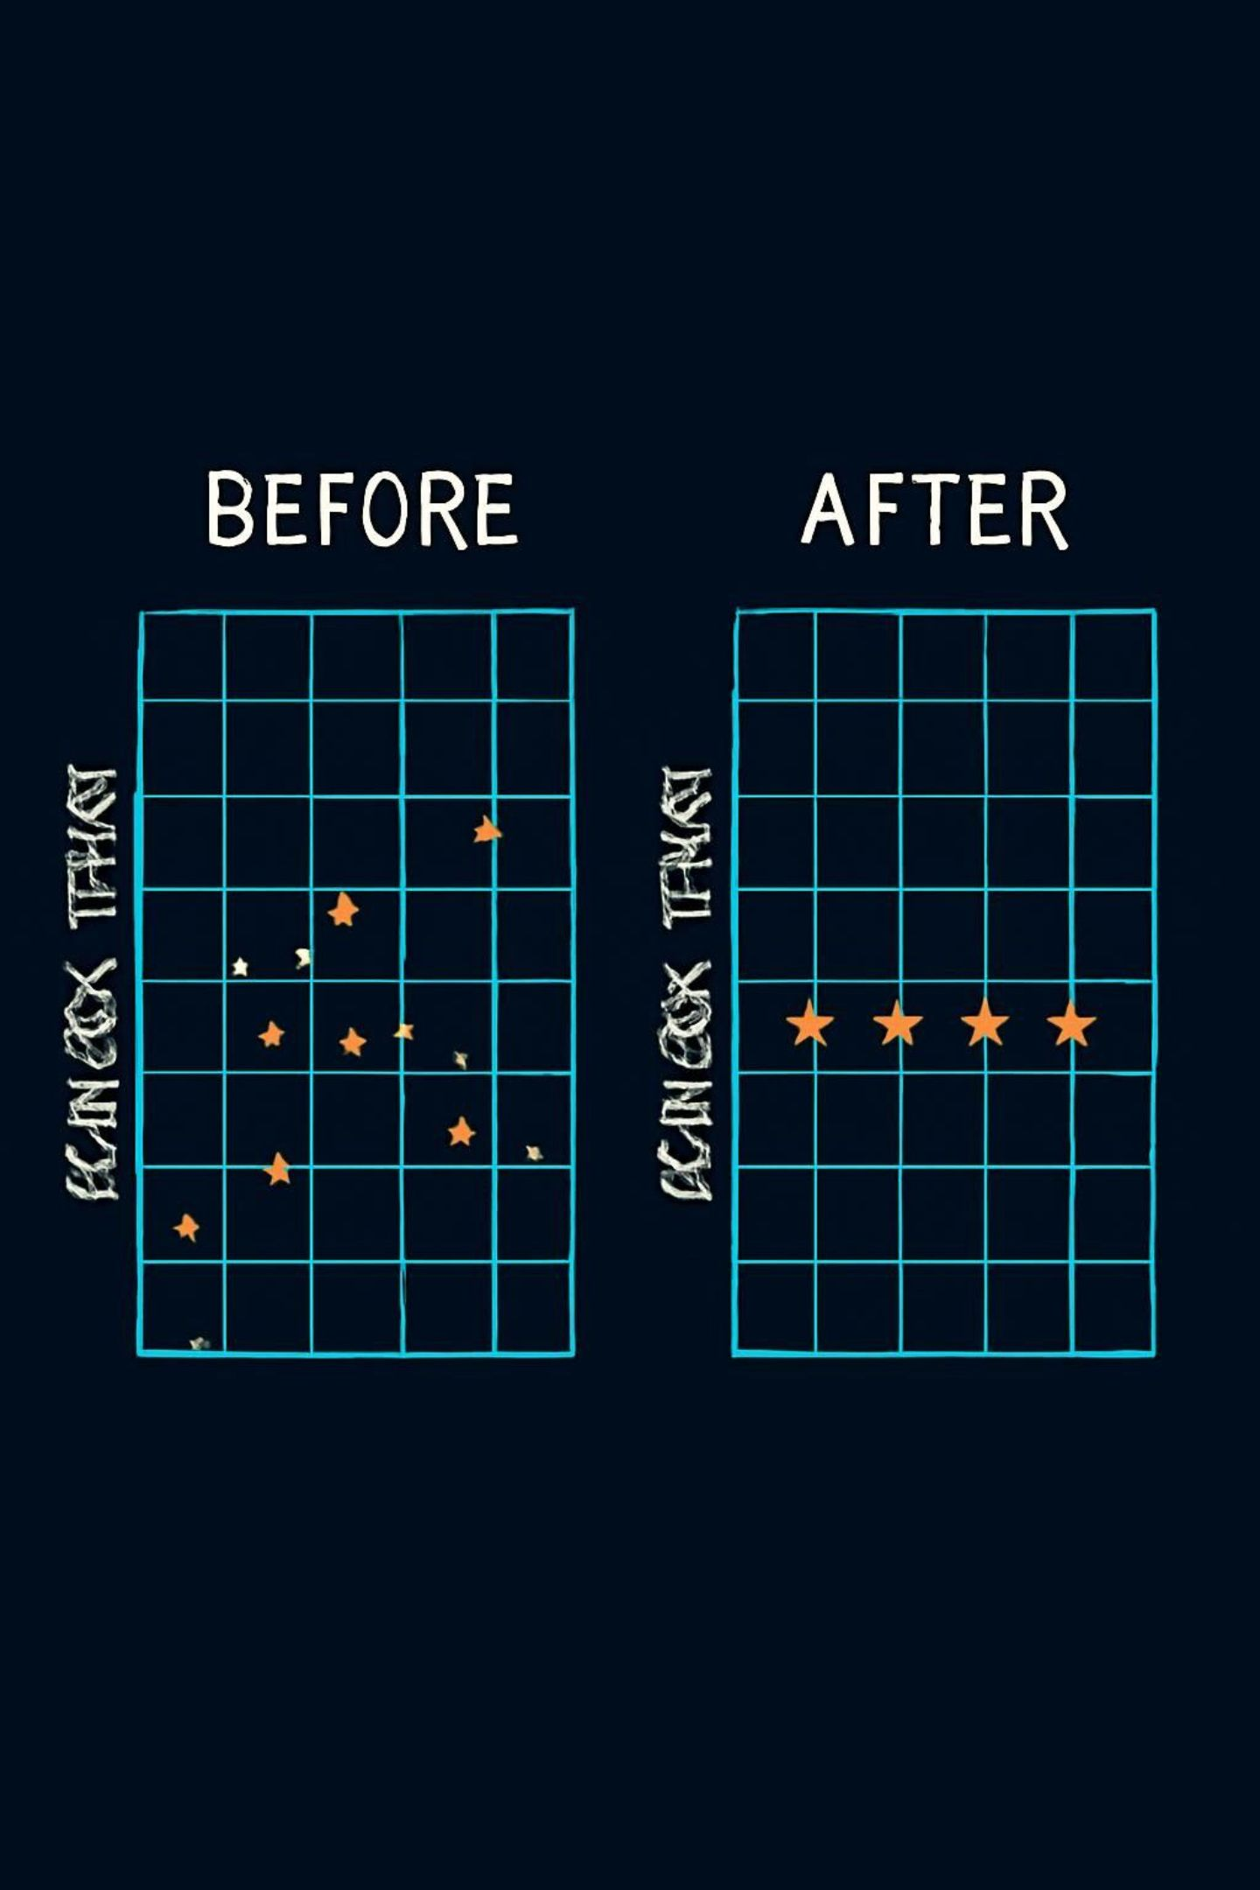
RESULT — ARRIVAL-TIME SYNCHRONIZATION
BEFORE ML ADJUSTMENT
AFTER ML ADJUSTMENT
EARLIER PROTOTYPE RUN
UAV 1: 35.36 s · UAV 2: 44.72 s · UAV 3: 22.36 s
Initial synchronization error: 7.8567
UAV 1: 44.97 s · UAV 2: 44.87 s · UAV 3: 45.09 s
FINAL SYNCHRONIZATION ERROR = 0.216 s
Prototype improvement recorded: 7.8567 → 0.1035 (separate earlier run; do not mix with final)
Graph shows arrival-time distribution reduction; final test achieved 0.216 s spread under the software prototype.

Slide 7
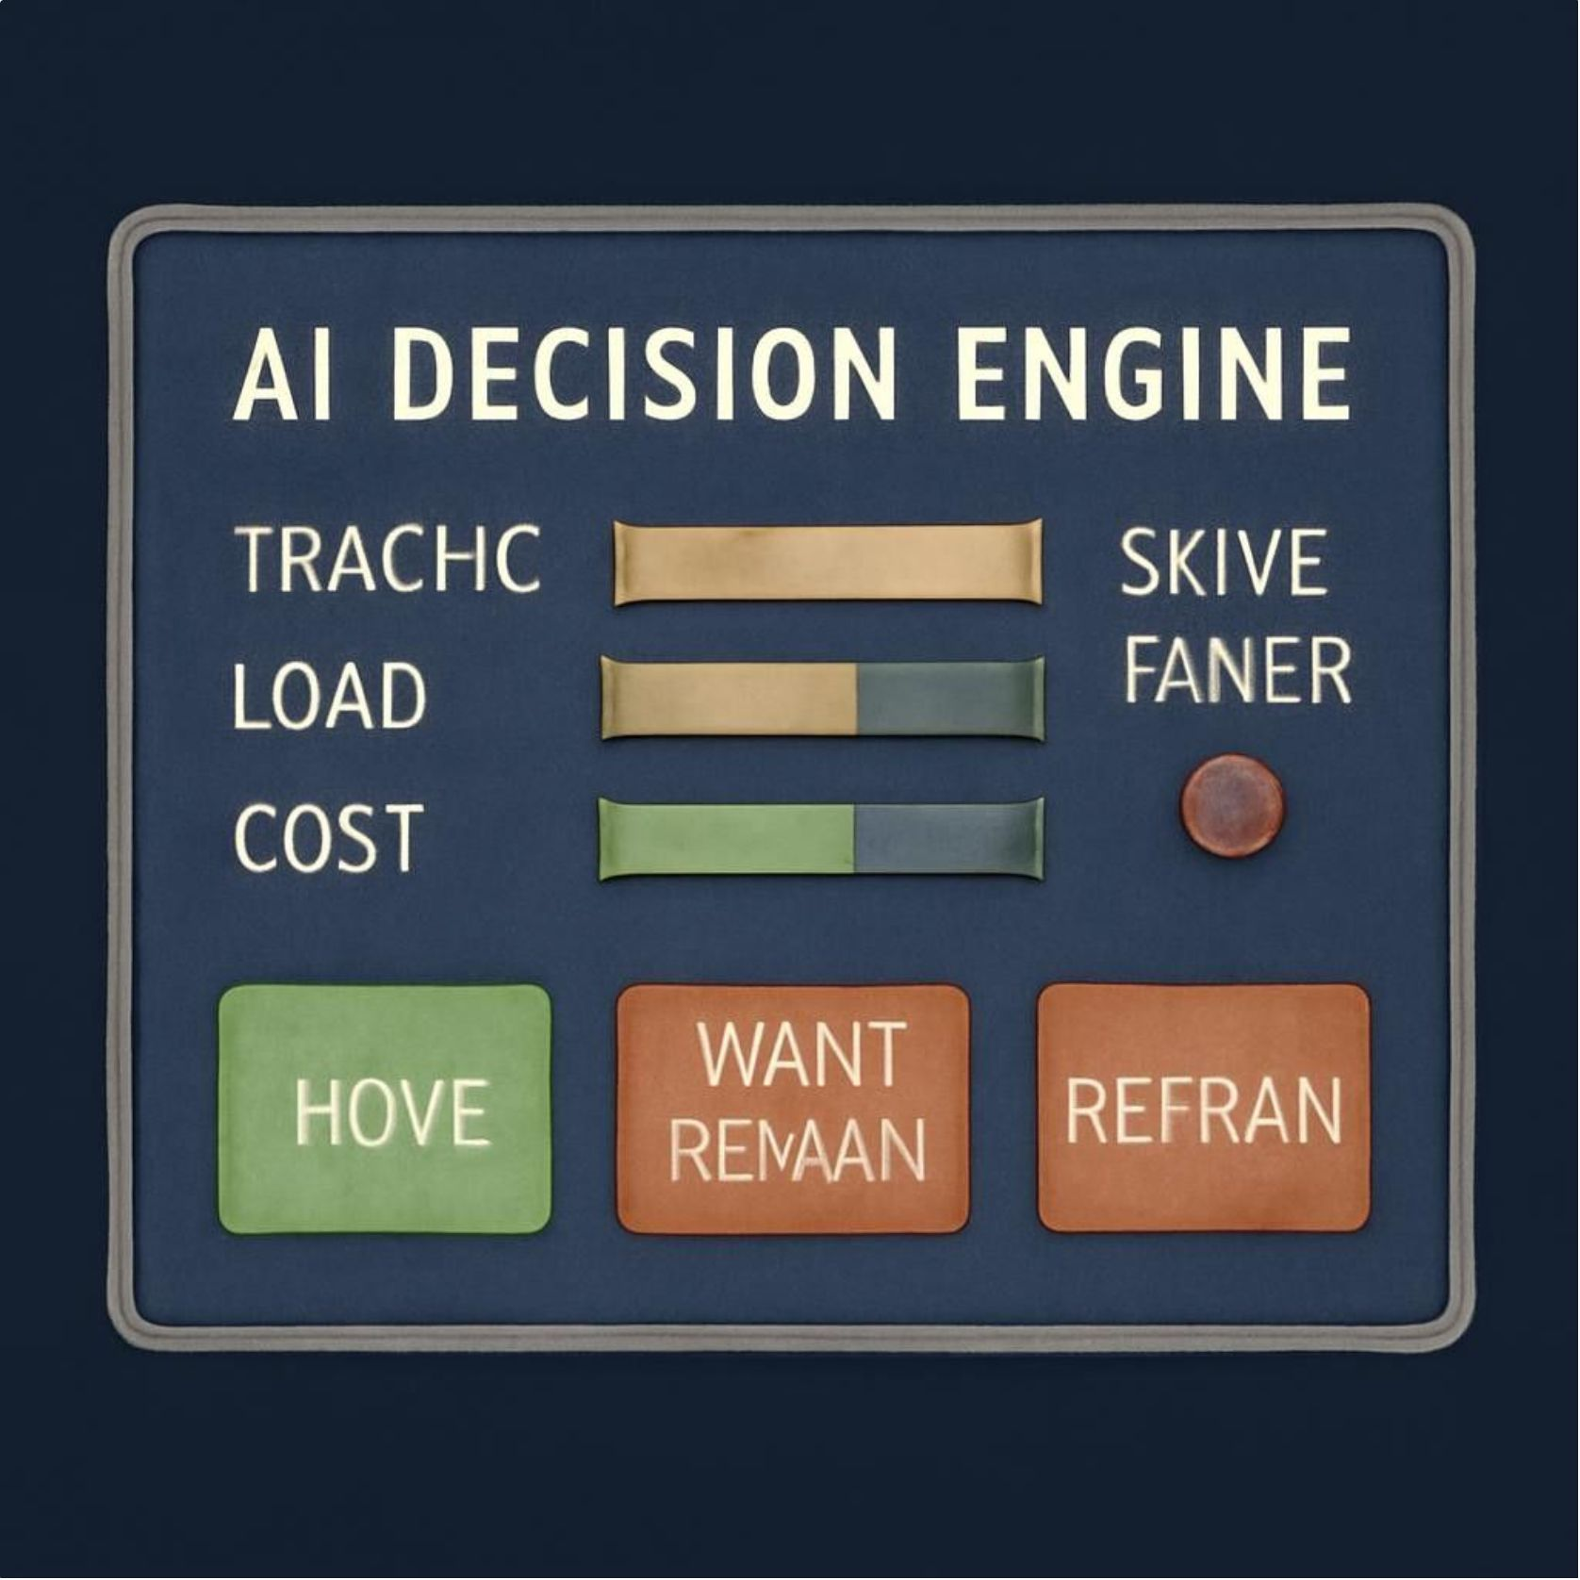

LAYER 2 — CONTEXTUAL BANDIT DECISION
Bandit inputs & prototype decisions
Inputs: TRAFFIC · LOAD · COST · SYNCHRONIZATION ERROR
Prototype example (sync error = 0.216):
UAV 1 — Traffic=0.30 · Load=0.40 · Cost=0.20 · Decision: WAIT
UAV 2 — Traffic=0.70 · Load=0.80 · Cost=0.70 · Decision: WAIT
UAV 3 — Traffic=0.50 · Load=0.60 · Cost=0.40 · Decision: WAIT
The selected action depends on the current context — WAIT is the prototype
example, not a universal outcome.

Slide 8
ADAPTIVE WAIT / RETAIN — DECISION CHANGES WITH THE ENVIRONMENT
STAGE 1 — MOVE
UAV advances toward target under predicted speed.
STAGE 2 — CONDITIONS CHANGE
TRAFFIC ↑ · LOAD ↑ (context updates)
STAGE 3 — WAIT / RETAIN
APPLIED SPEED = 0.000 m/s · STATUS: UAV WAITING / RETAINING
STAGE 4 — REASSESS
NEW CONTEXT → BANDIT → NEW ACTION (MOVE / WAIT / RETRAIN)
Prototype time-step example: Time step 1 → all UAVs WAIT; environment changes → time step 2 → bandit recomputes actions. WAIT is temporary retention, not permanent stop.

Slide 9
CURRENT PROGRESS — WORKING SOFTWARE PROTOTYPE
ML MODEL
SYNCHRONIZATION
MAE = 0.0294 · R² = 0.9891
Initial Error = 7.8567 · Prototype Final Error = 0.1035
FINAL UAV TEST
ARRIVAL TIMES
UAV 1 = 0.629 m/s · UAV 2 = 0.498 m/s · UAV 3 = 0.496 m/s
UAV 1 = 44.97 s · UAV 2 = 44.87 s · UAV 3 = 45.09 s · Final spread = 0.216 s
Contextual bandit available: MOVE · WAIT / RETAIN · RETRAIN · PROTOTYPE STATUS: WORKING

Slide 10
PROJECT STATUS — WHAT IS DONE AND WHAT COMES NEXT
COMPLETED
REMAINING WORK
✓ ML training pipeline implemented
✓ UAV speed prediction implemented
→ Connect to real-time UAV telemetry
→ Integrate a full digital-twin simulation (higher-fidelity physics)
✓ Synchronization calculation implemented
✓ ML-predicted UAV speeds tested
→ Improve online contextual-bandit learning (lower regret, nonstationary context)
→ Implement robust adaptive retraining pipeline (safety & validation)
✓ Arrival-time synchronization demonstrated
✓ Contextual inputs implemented: Traffic / Load / Cost / Sync Error
→ Validate with larger and more realistic datasets
→ Hardware / real-UAV or hardware-in-the-loop validation (future work)
✓ Contextual bandit implemented · MOVE / WAIT / RETRAIN logic demonstrated
✓ WAIT / RETAIN execution & dynamic reassessment demonstrated
✓ Animated visualization prototype created

Slide 11
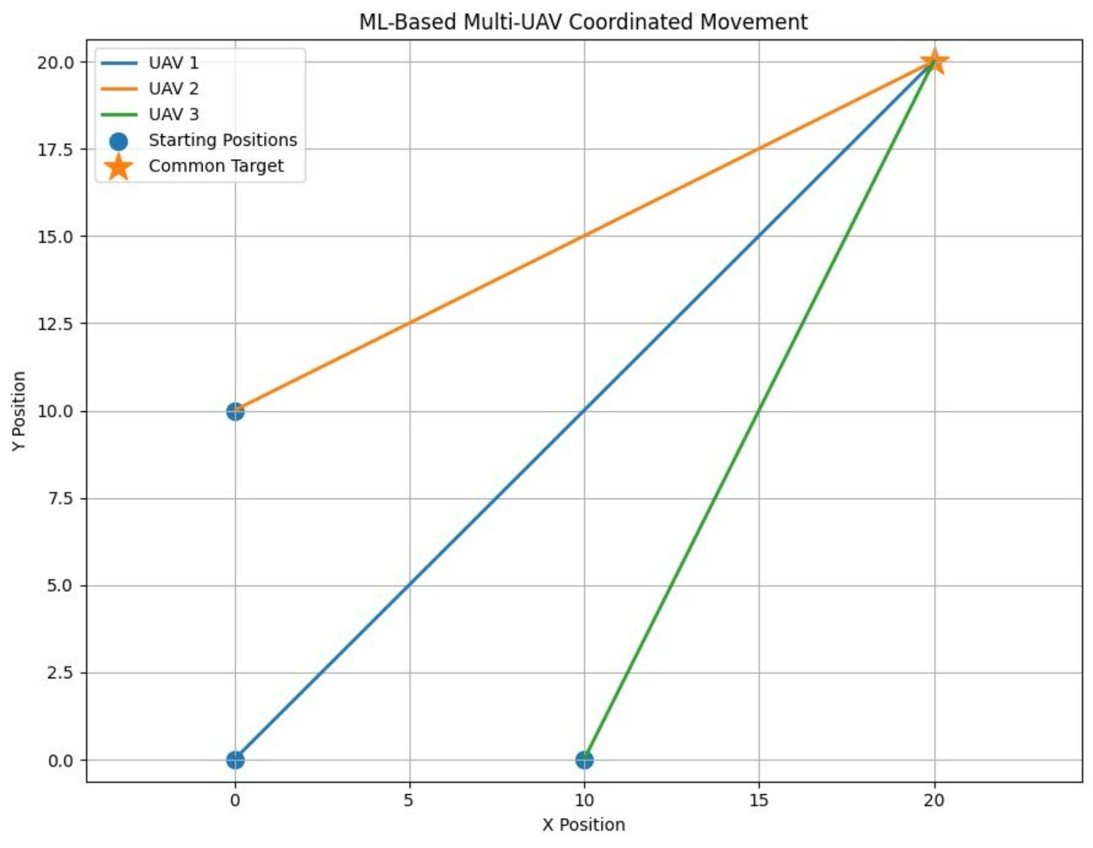
Three UAVs start from different positions.
Each UAV has a different distance to travel.
The orange star represents the common target point.
The blue dots represent the initial positions.
The colored lines show the individual UAV paths.
ML calculates suitable speeds for each UAV.
The speed adjustment helps the UAVs coordinate their arrival.
This demonstrates the project's multi-UAV synchronization and coordinated movement.

Slide 12
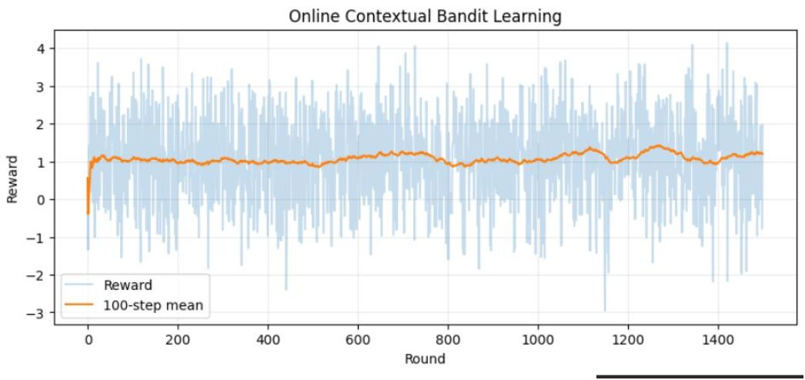
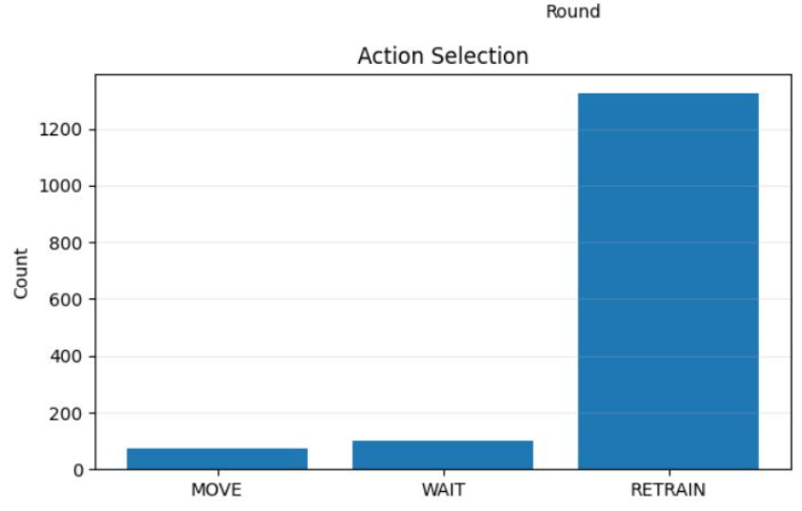
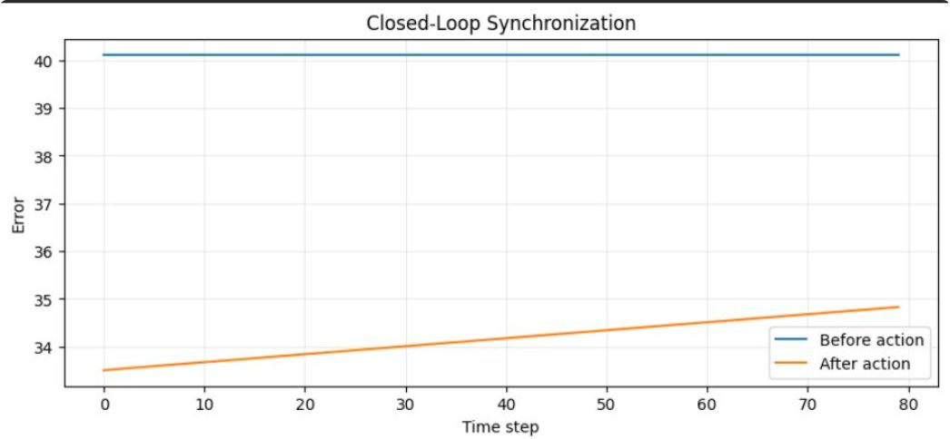
STIMULATED OUTPUT
The graph shows how the contextual bandit learns over time. The orange line is the average reward, which stays fairly stable, showing consistent learning and decision-making.
The graph compares synchronization error before and after the UAV action. It shows how the system monitors the error and adjusts the UAVs through the closed-loop process.
The graph shows how often the bandit selected each action. RETRAIN was selected most frequently, followed by WAIT, while MOVE was selected the least. This shows the model’s current action preference in the simulated environment.

Slide 13
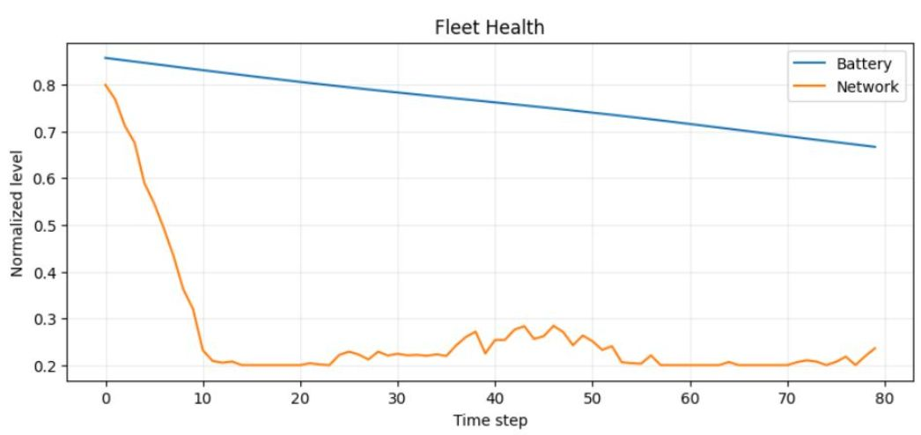
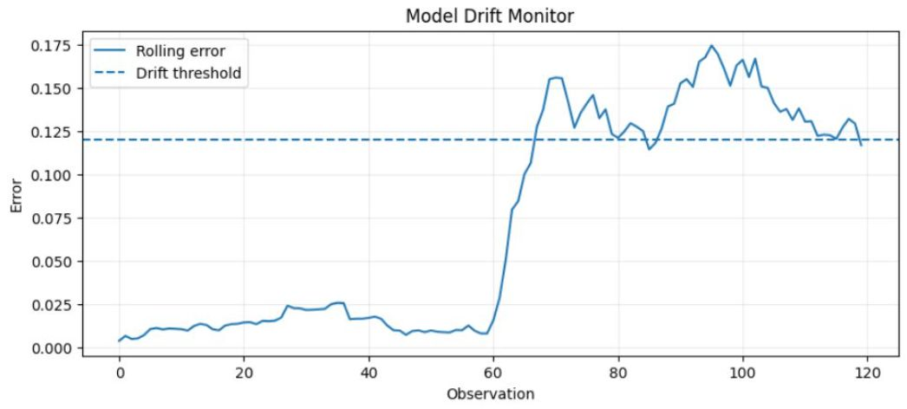
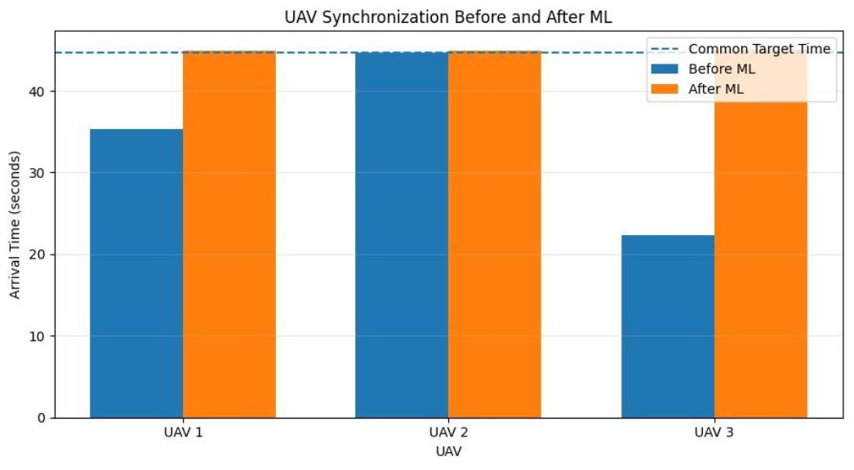
The graph shows fleet health over time. Battery gradually decreases, while network quality changes dynamically during the mission.
The graph shows model drift detection. When the rolling error crosses the threshold, the system detects that the model’s accuracy has degraded and triggers retraining.
The graph compares UAV arrival times before and after ML-based synchronization. The ML-adjusted speeds bring all three UAVs close to the common target time of about 44.7 seconds, reducing the difference in their arrival times.

